Slide 1


COURSE REGISTRATION &
TIME TABLE GENERATION
Submitted By:-
Pranjal Jain (Project Manager) - 21ucs155
Vaibhav Rai - 21ucs225
Vaibhav Khamesra - 21ucs224
Pranjal Bansal - 21ucs154
Pranjal Mishra - 21ucs156

Slide 2


PURPOSE
to implement an online course registration system in place of manual course registration for university students with a user-friendly interface and in a cost-effective manner
to develop a timetable generator that can schedule classes across all batches and courses.

Slide 3

PRODUCT SCOPE
The project aims to develop an Online Course Registration System that ensures user-friendliness for both students and administrators, allowing only fee-paid students to register for courses, select program electives, and enabling faculty to manage their teaching assignments and student grades.
Additionally, a timetable generator will automate the scheduling of lectures, ensuring breaks for students and lecturers, and avoiding schedule conflicts, providing efficient management of academic timetables.
The integrated system offers comprehensive record-keeping capabilities for the institution, including student records, course information, and fee management, streamlining administrative tasks and enhancing overall educational efficiency.

Slide 4

PRODUCT PERSPECTIVE
The project involves creating a user-friendly Online Course Registration System and a Time Table Generator to replace manual processes, offering easy access and reducing errors, resulting in improved efficiency and cost-effectiveness for college-level registration tasks.
The Online Course Registration System addresses the challenge of handling large-scale physical file systems, providing attractive interfaces and streamlined functions, ultimately enhancing the overall registration experience for students and administrators.
The Time Table Generator automates the complex task of scheduling lectures by incorporating course, faculty, and lecture hall details, optimizing the allocation of resources and ensuring that breaks are scheduled appropriately, thereby increasing operational efficiency.

Slide 5

PRODUCT FUNCTIONS
Authentication will be done through username and password for both admins and students separately.
The administrator can choose from three options add/ delete/ modify courses available; initiate the registration process; and generate a timetable based on the added courses.
Admin will add details regarding courses available for registration and register students in their respective core courses.
Students will verify their details, choose whether to drop or add a course, and will get a confirmation slip/ course registration slip as an acknowledgment.
Proof will be provided in the form of a registration report once the process has been submitted and terminated.
The course instructor, with her/his credentials, can access the list and details of registered students.
The Timetable generator will generate a timetable based on the data received through the process of Course registration, i.e., the number of students registered per course and the availability of lecture halls and lecturers

Slide 6

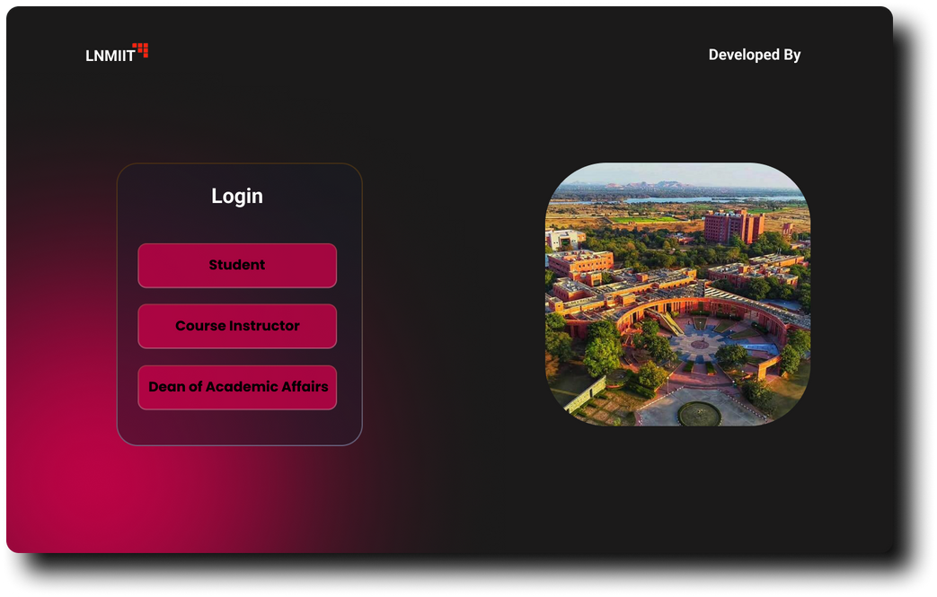
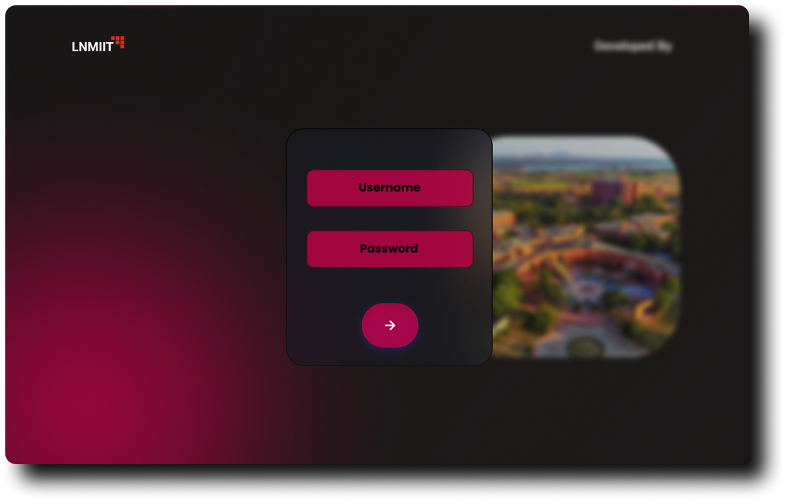
USER INTERFACE

Slide 7
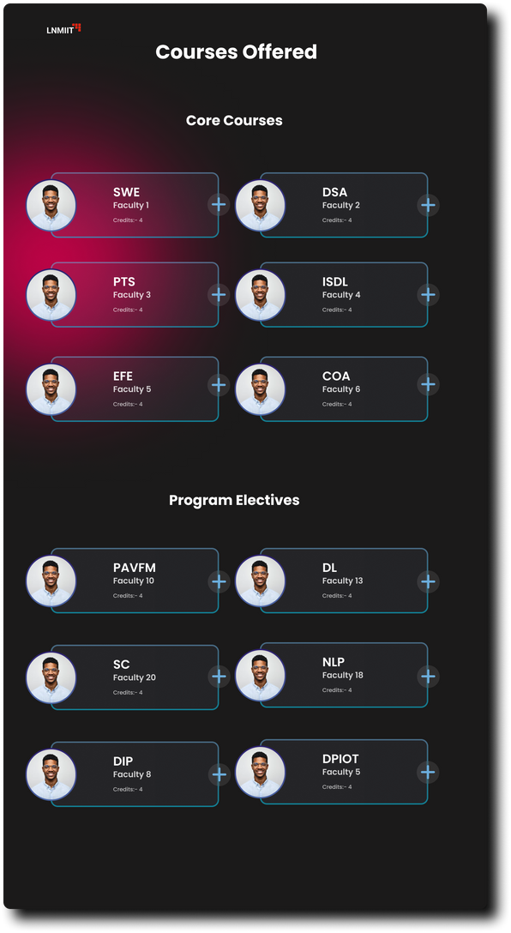
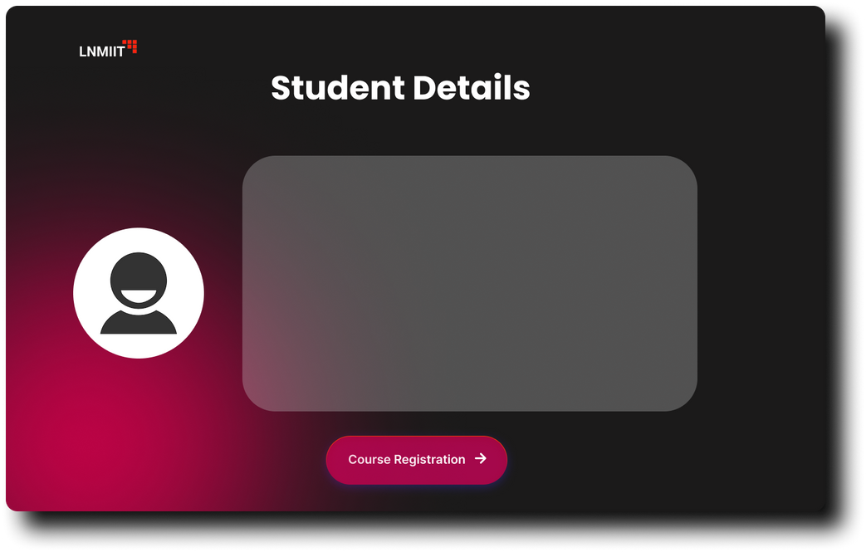
USER INTERFACE

Slide 8
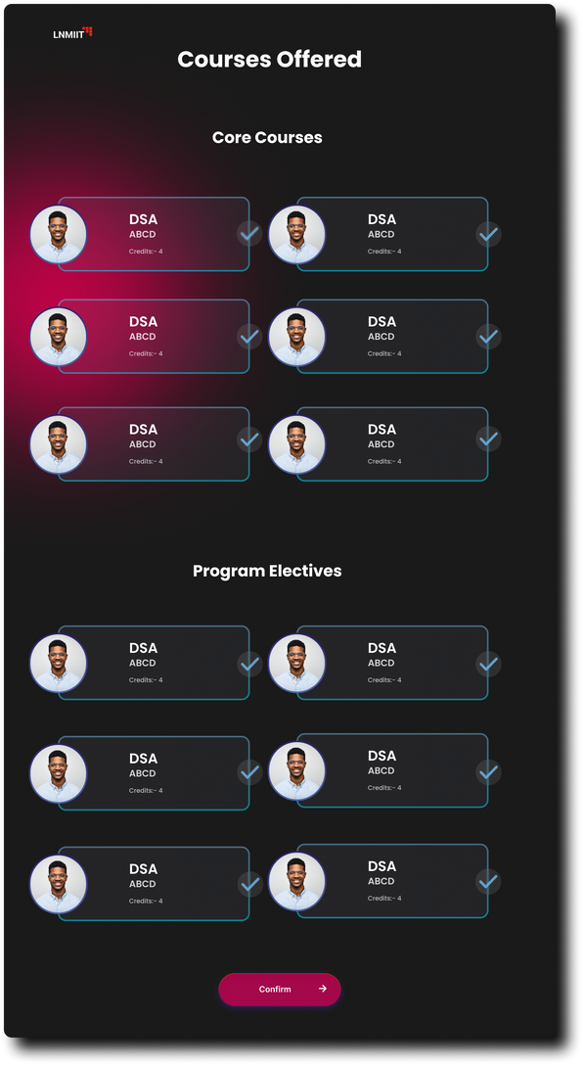
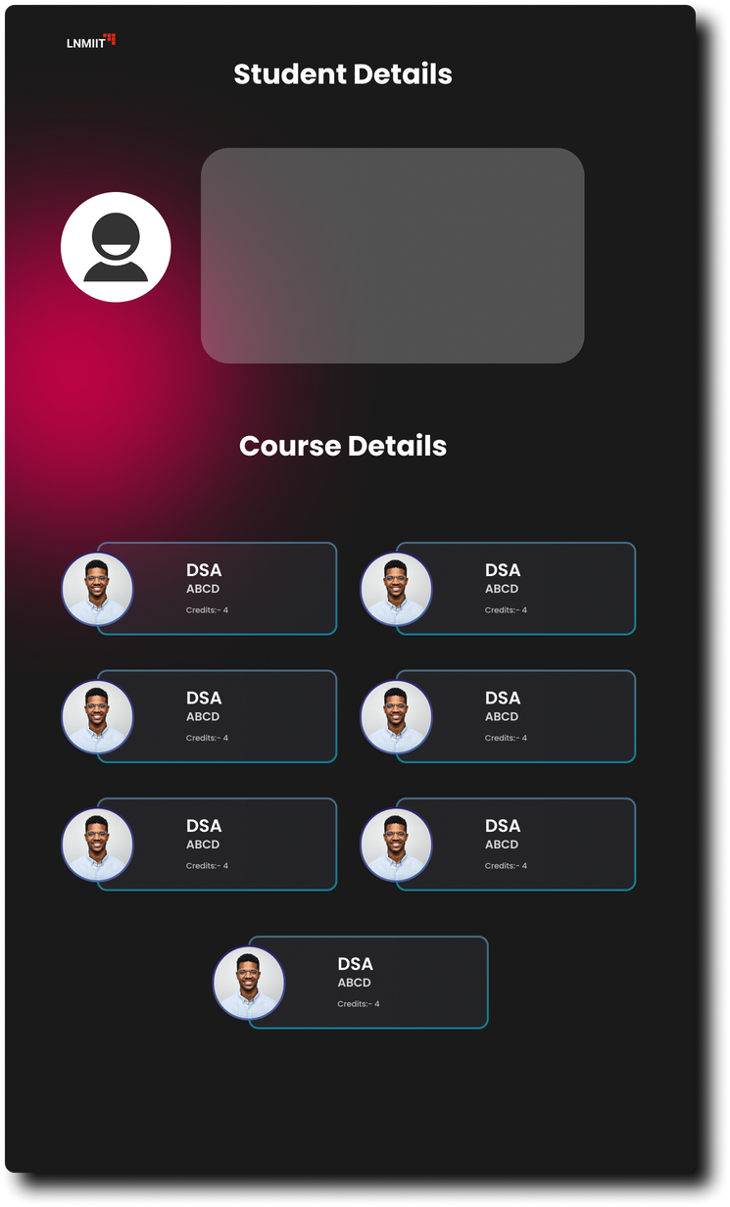
USER INTERFACE

Slide 9

HARDWARE INTERFACES
The software will interact with the hardware components of the system in the following ways:
Supported Devices: The software will be accessible through standard web browsers on various hardware devices, including desktop computers, laptops, tablets, and smartphones.
Data and Control Interaction: Data transfer and control interactions between the software and the hardware will be through standard HTTP and HTTPS protocols.
Communication Protocols: The software will use HTTP/HTTPS for communication between the client and server.

Slide 10

SOFTWARE INTERFACES
The software will interface with the following software components and services:
Database: The system will use a MongoDB database to store course information, user profiles, and scheduling data. Data will be accessed using MongoDB drivers.
Server Framework: The software will utilize Node.js with Express.js as the server framework for handling API requests.
Web Client: The user interface will be developed using React for a responsive and interactive web experience.
External Services: The system will integrate with email services for sending notifications and confirmations. Email services will be accessed via standard email protocols (e.g., SMTP).

Slide 11


SYSTEM FEATURES
User Registration and Timetable Creation
Users register for courses, create timetables, and receive confirmations.
Admin Course Management
Administrators manage course offerings, including addition, modification, and removal.
Timetable Generation for Administrators
Administrators generate and display timetables for registered students.
Email Notifications
The system sends email notifications for important updates to users.

Slide 12

OTHER NON FUNCTIONAL REQUIREMENTS
Performance Requirements
Response Time and User Experience: The system must respond within 2 seconds for user actions and support at least 1000 concurrent users during peak periods to maintain a smooth and responsive user experience.
Efficient Timetable Generation: Timetables must be generated within 10 seconds for a typical course schedule to ensure efficient scheduling.
Data Management: The system should maintain historical data without compromising performance, ensuring the preservation of registration and scheduling information.

Slide 13

OTHER NON FUNCTIONAL REQUIREMENTS
Safety Requirements
1.Data Backup: The system shall perform daily automated data backups to prevent data loss.
2.Error Handling: The software should provide robust error-handling mechanisms to prevent critical system failures.
3.Security Measures: The software shall implement security features to protect user data and prevent unauthorized access or breaches.
4.External Policies: Compliance with data protection regulations and industry best practices

Slide 14

OTHER NON FUNCTIONAL REQUIREMENTS
Security Requirements
User Authentication: Users shall be required to authenticate using secure methods, such as username and password, for access.
Data Encryption: User data shall be encrypted during transmission (HTTPS) and storage to ensure data privacy.
Authorization: Users shall only have access to data and functionality that they are authorized to use based on their roles and permissions.
Intrusion Detection: The system shall have an intrusion detection system (IDS) to monitor and respond to security breaches.
External Policies: Adherence to data protection regulations and security best practices.

Slide 15

OTHER NON FUNCTIONAL REQUIREMENTS
Software Quality Attributes
Usability: The software should be user-friendly, with clear and intuitive navigation.
Reliability: The system shall operate without unexpected interruptions and provide accurate data.
Maintainability: The software code shall follow best practices and be well-documented for easy maintenance and future enhancements.
Flexibility: The software shall be designed to accommodate changes or updates in requirements with minimal impact on the overall system.
Availability: The system should be available for use during specified uptime hours, ensuring that users have access when needed.
Relative Preferences: Usability is preferred over ease of learning, while maintainability is important for long-term sustainability.

Slide 16

OTHER NON FUNCTIONAL REQUIREMENTS
Business Rules
Administrator Privileges: Only administrators can generate timetables, manage course offerings, and modify student registrations.
Registration Rules: The system shall enforce university policies on course prerequisites, capacity limits, and scheduling constraints during registration.

Slide 17

OTHER REQUIREMENTS
Database Management
The software will utilize a MongoDB database for storing course information, user profiles, and scheduling data, with daily backups and defined data retention policies.
Legal Compliance
The software will adhere to relevant data protection regulations (e.g., GDPR or HIPAA), and users will be required to agree to privacy policies and terms of use.
Code Reusability
The development team will actively seek opportunities to reuse existing code libraries and components, encouraging code reusability and maintaining a repository for future projects to enhance efficiency and reduce development effort.

Slide 18
DESIGN DIAGRAMS

Slide 19
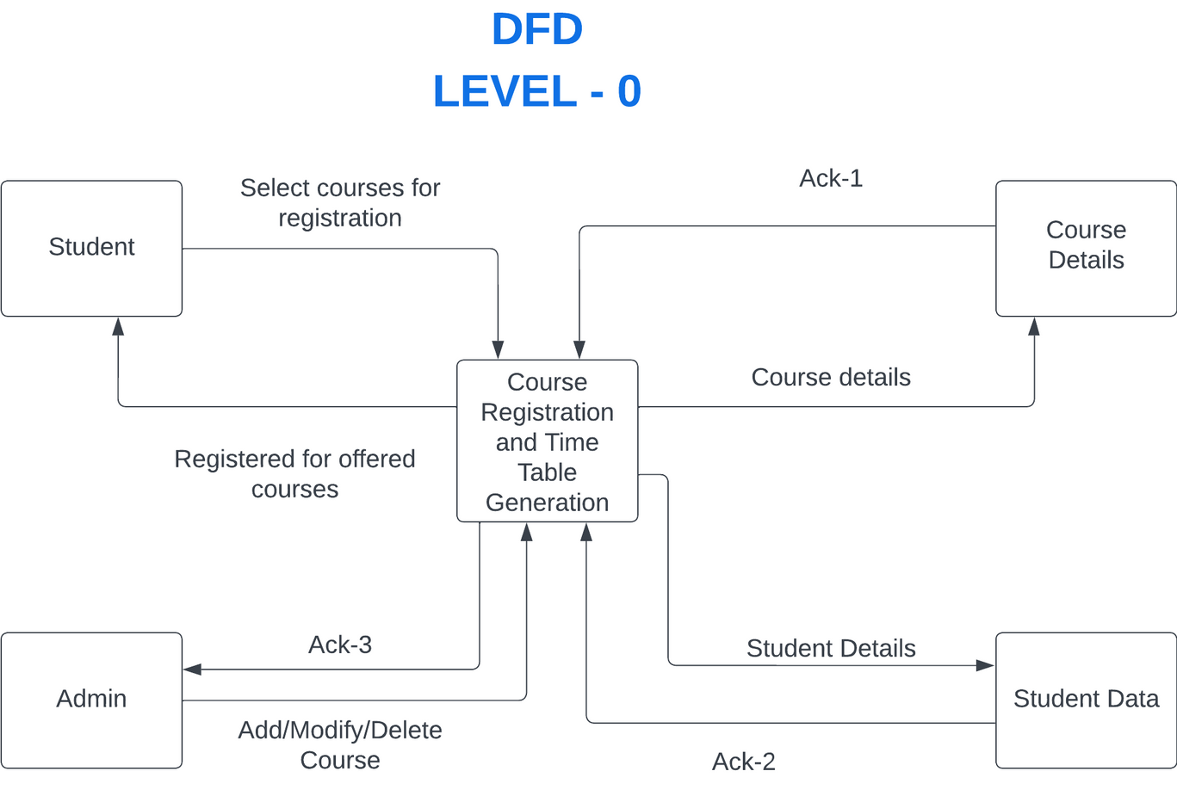
DFD LEVEL 0

Slide 20
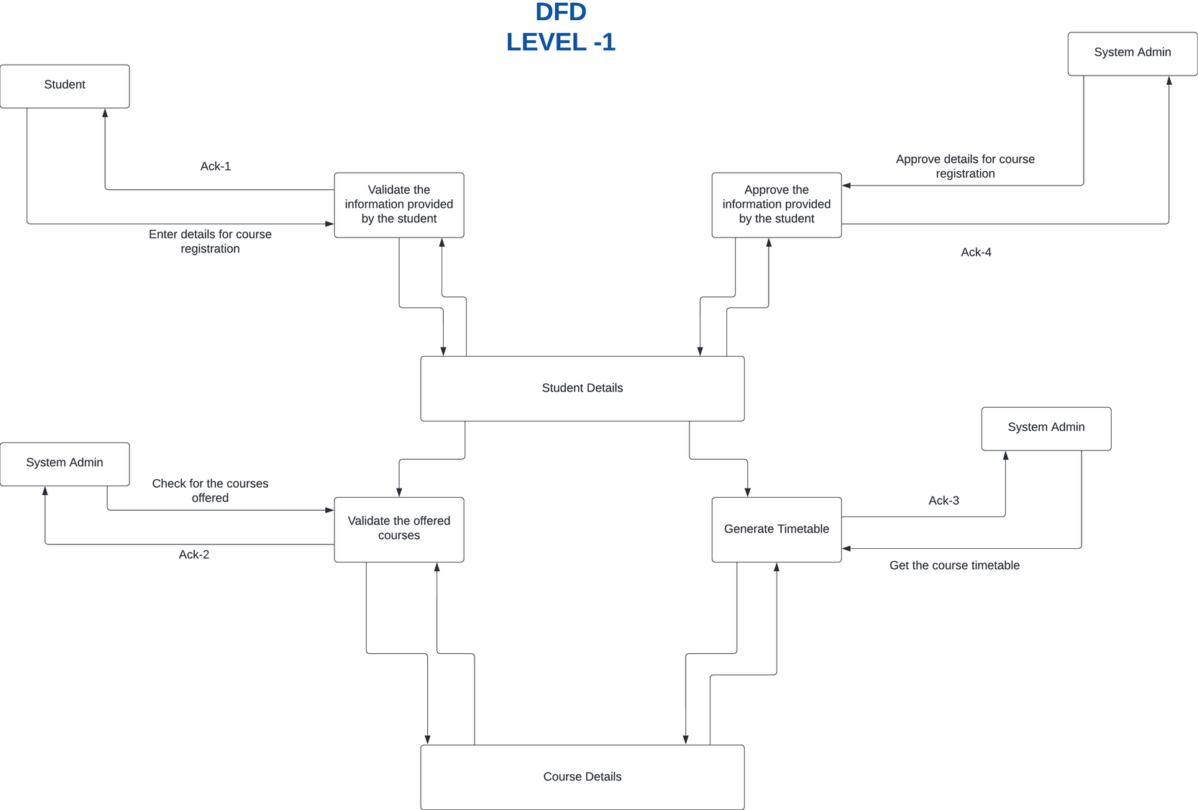
DFD LEVEL 1

Slide 21
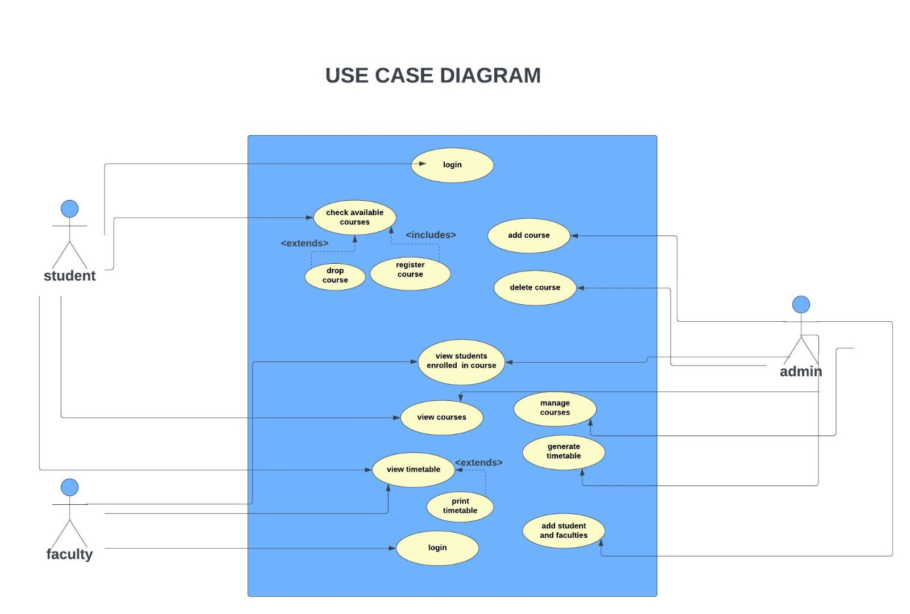
USE CASE DIAGRAM

Slide 22
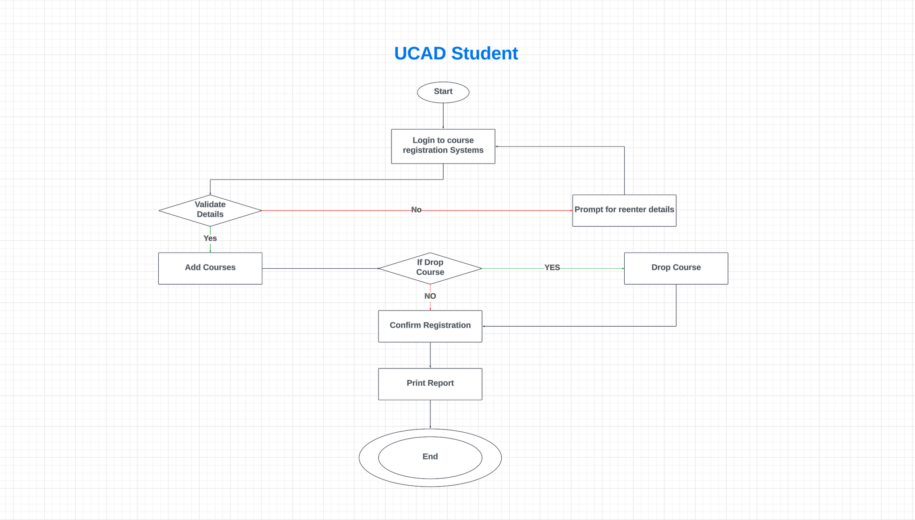
UCAD:
STUDENT

Slide 23
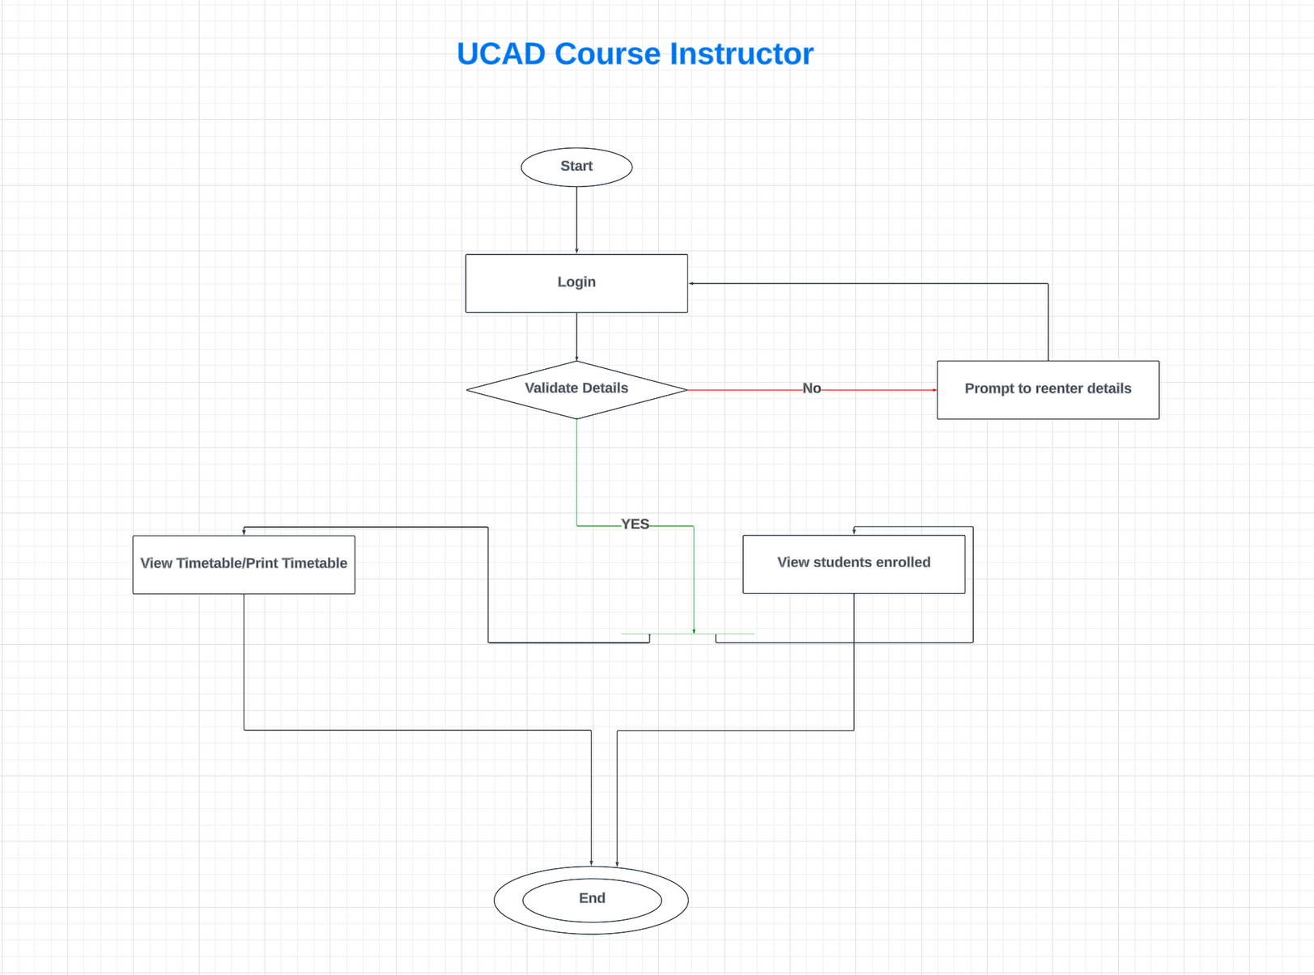
UCAD: COURSE
INSTRUCTOR

Slide 24
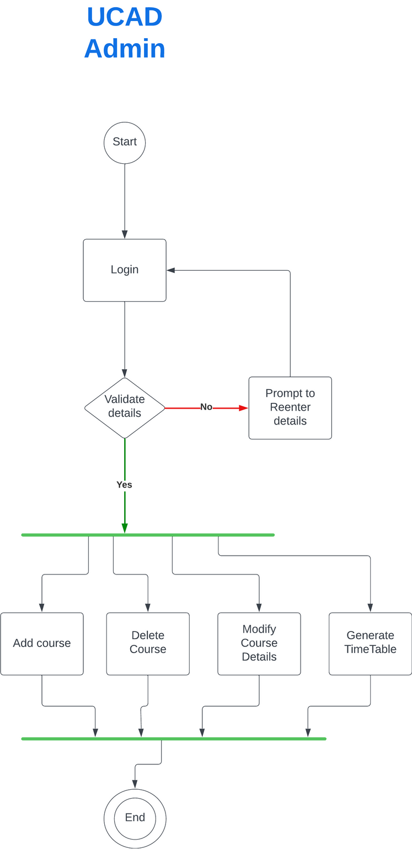
UCAD:ADMIN

Slide 25
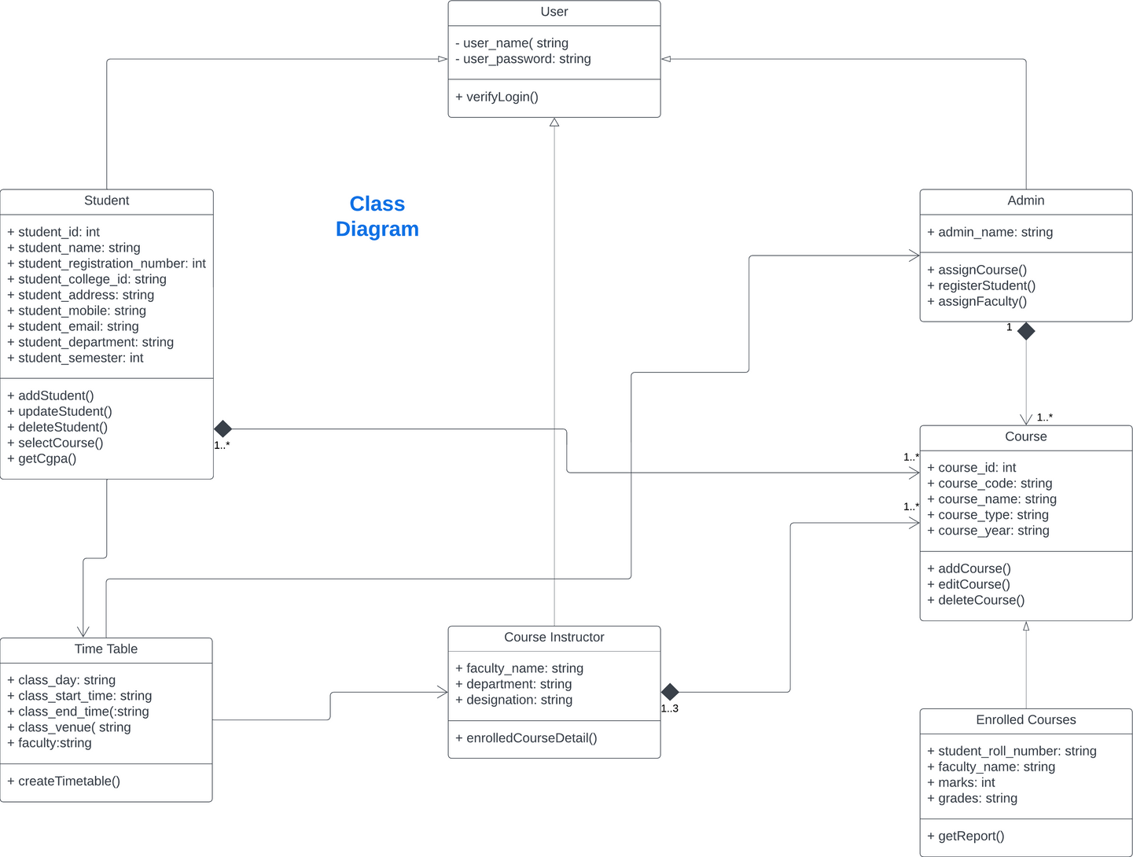
CLASS DIAGRAM

Slide 26
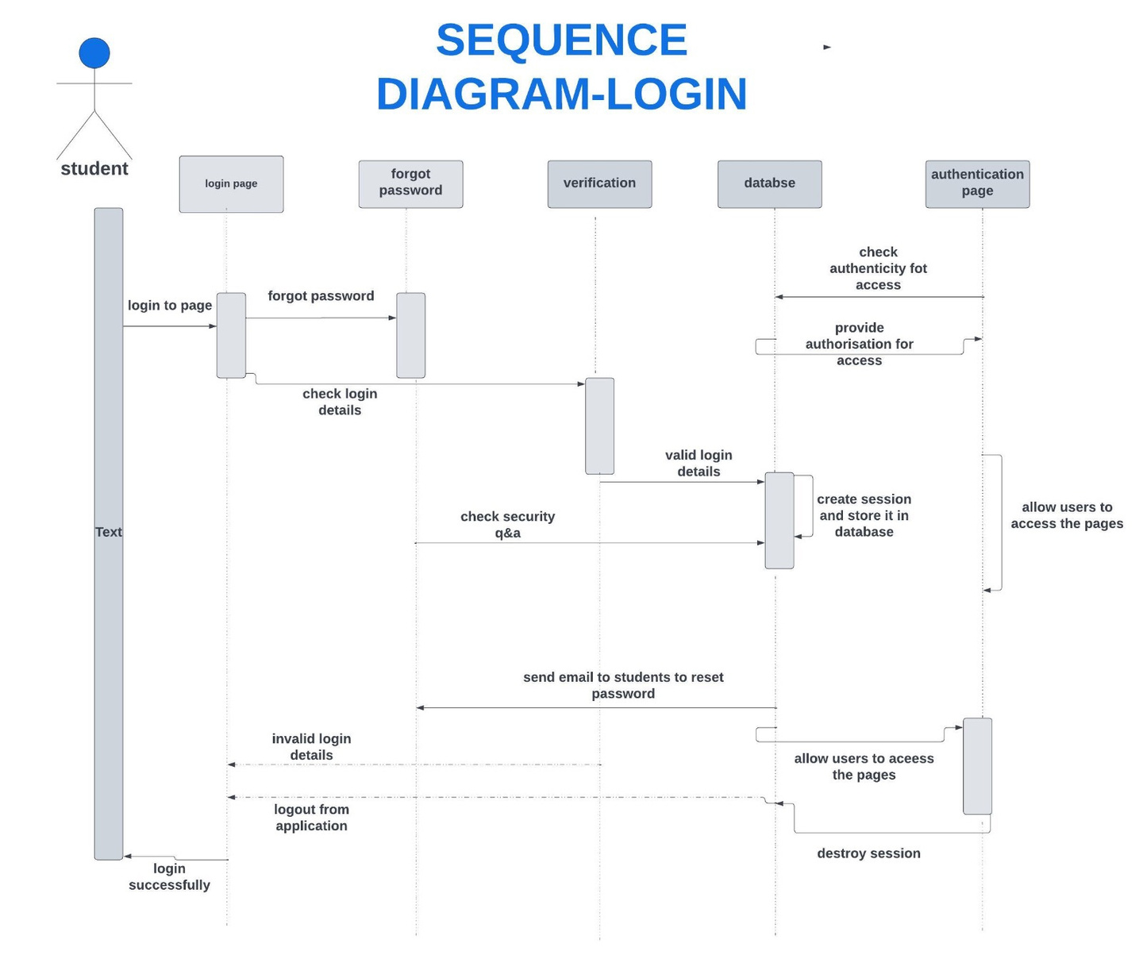
SEQUENCE DIAGRAM-LOGIN

Slide 27
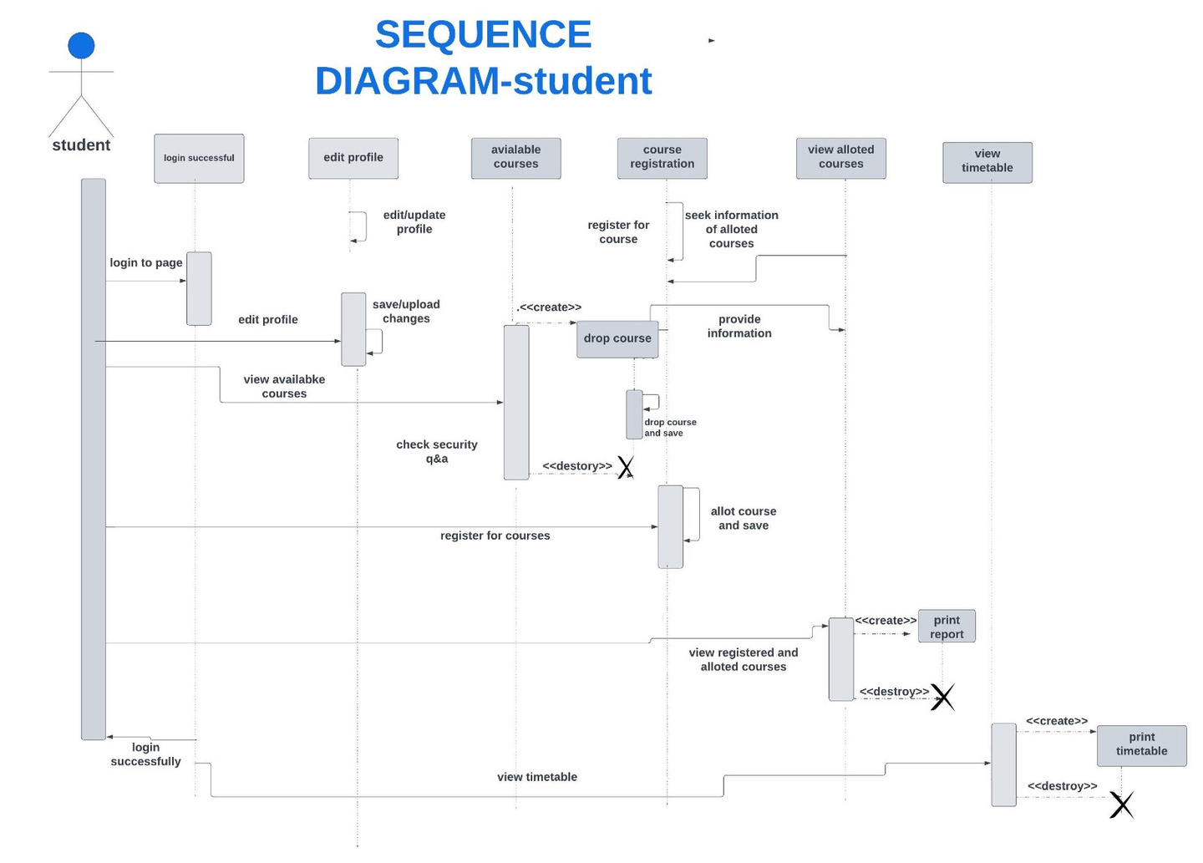
SEQUENCE DIAGRAM-STUDENT

Slide 28
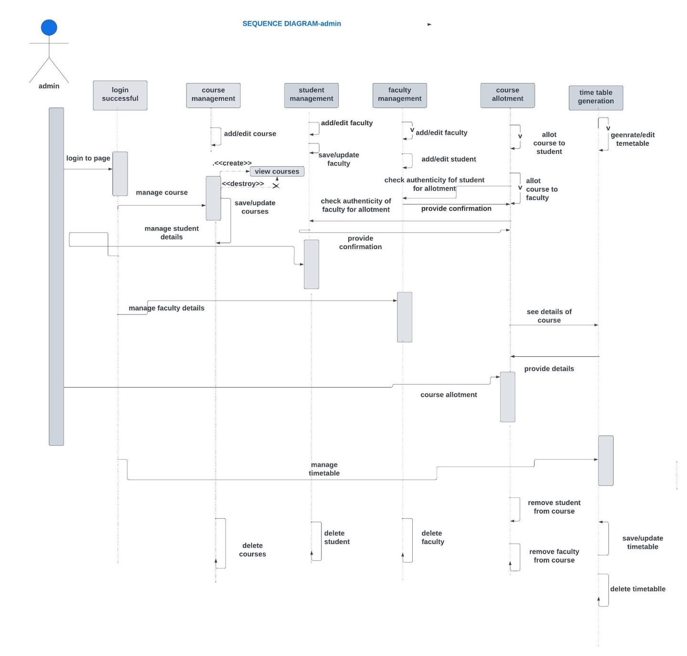
SEQUENCE DIAGRAM-ADMIN

Slide 29
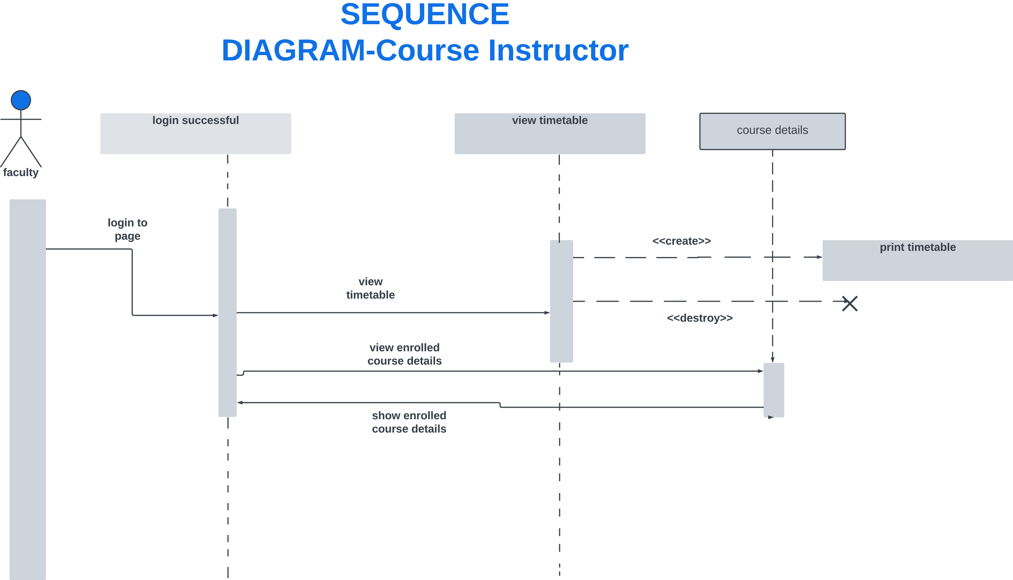
SEQUENCE DIAGRAM-COURSE INSTRUCTOR

Slide 30
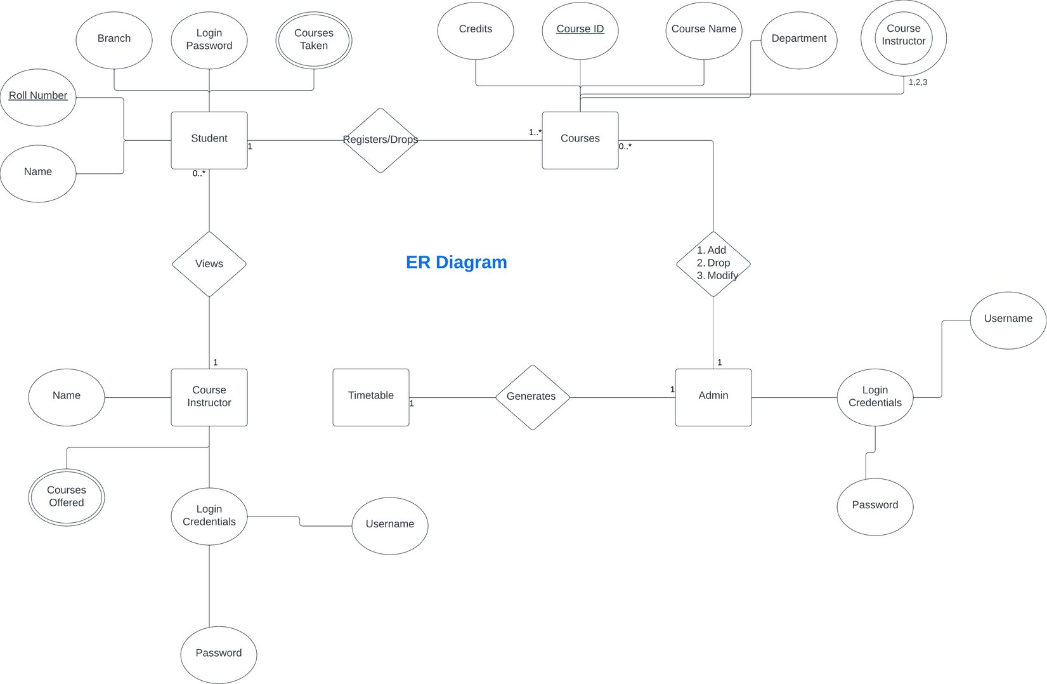
ER DIAGRAM

Slide 31



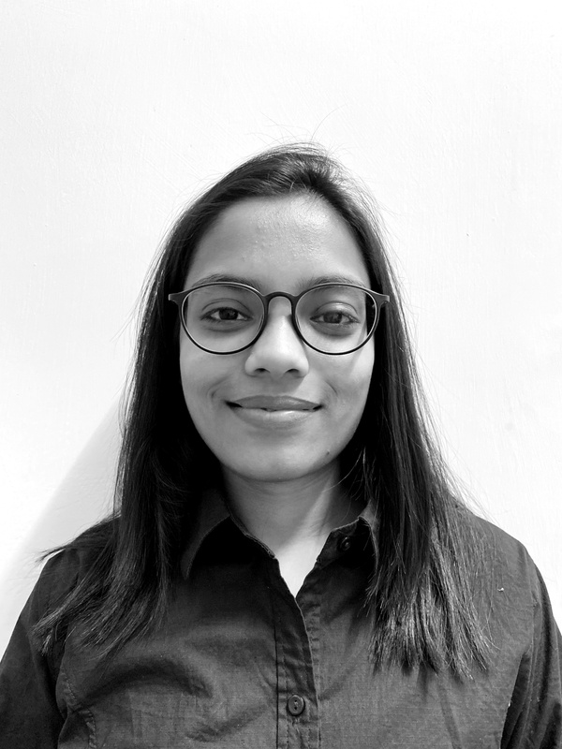
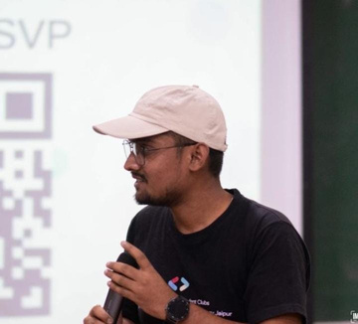
THANK YOU

